Slide 1
Why Visualize Data?

Slide 2
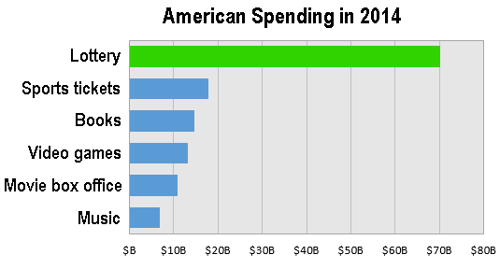
Why visualize data?
To communicate numbers?
The Single Largest Tax on Poor Families: the Lottery? Metrocosm

Slide 3
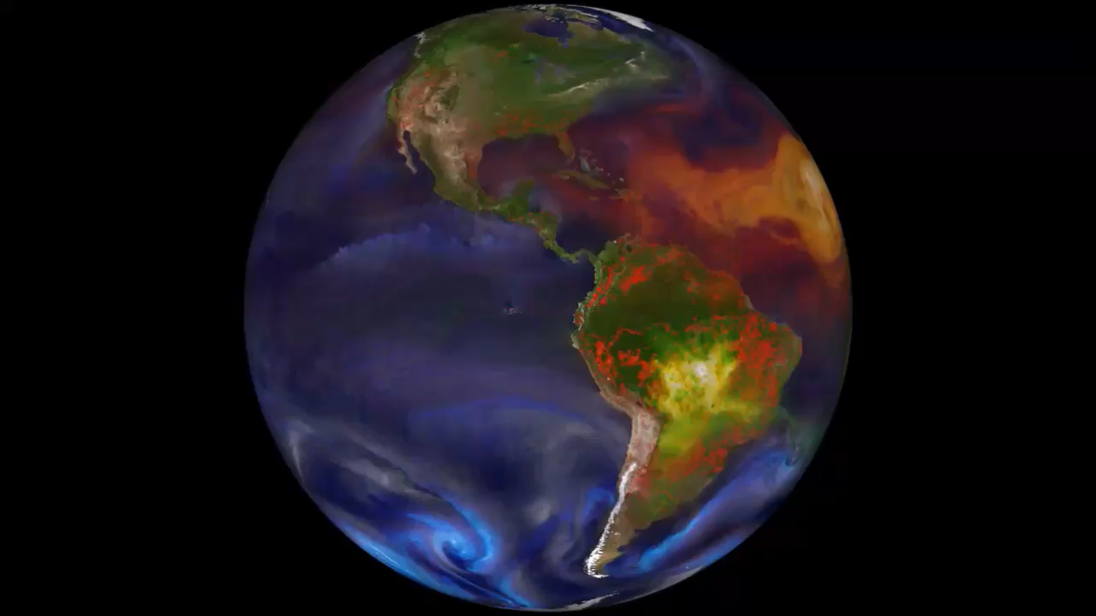
Why visualize data?
Communicate numbers?
Make sense of complex data?
GEOS-5 Nature Run, NASA

Slide 4
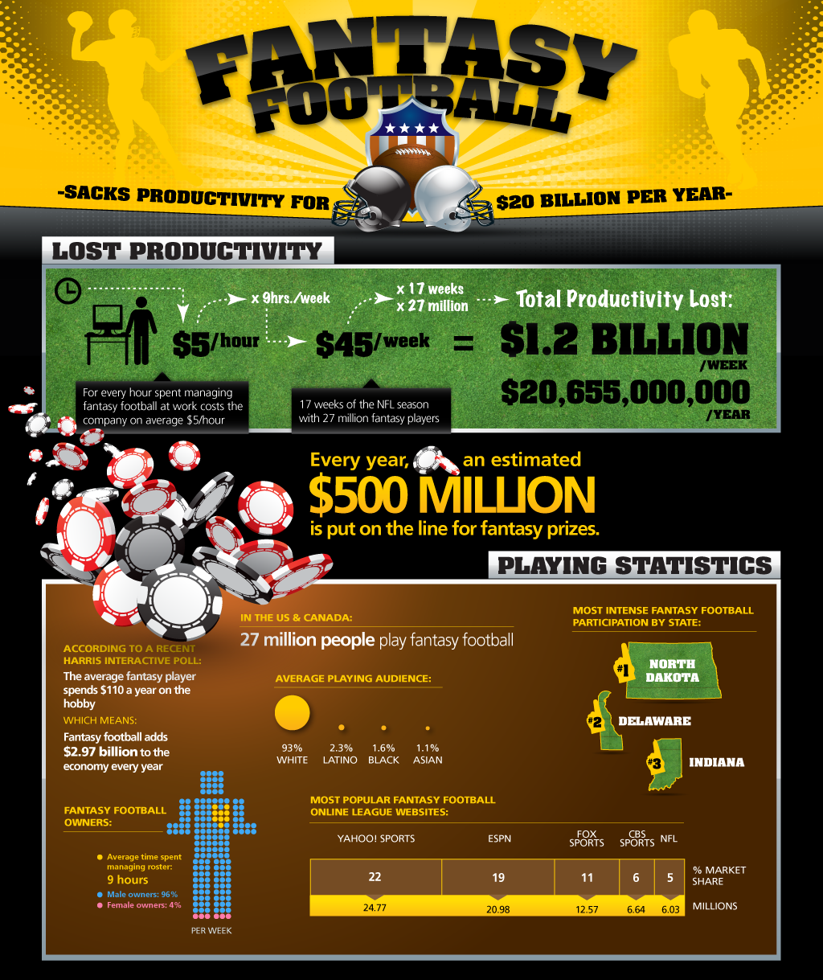
Why visualize data?
Communicate numbers?
Make sense of complex data?
Entertainment / marketing?
How Fantasy Football Sacks Productivity

Slide 5
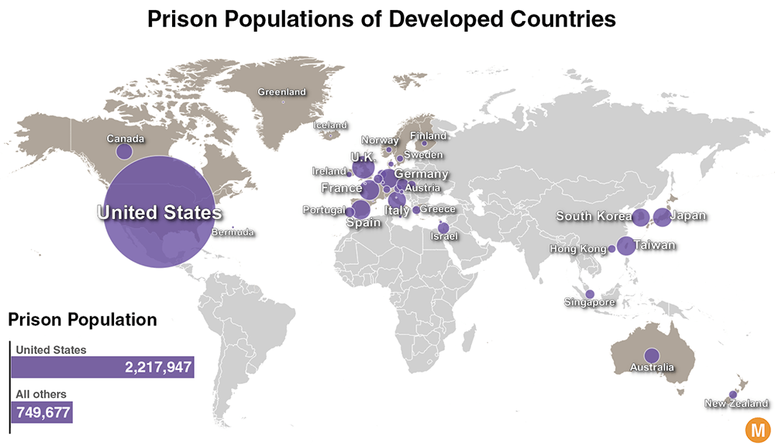
Why visualize data?
Make sense of complex data?
Entertainment / marketing?
Communicate numbers?
Present a persuasive argument?
Incarceration Rates in Developed Countries, Metrocosm

Slide 6
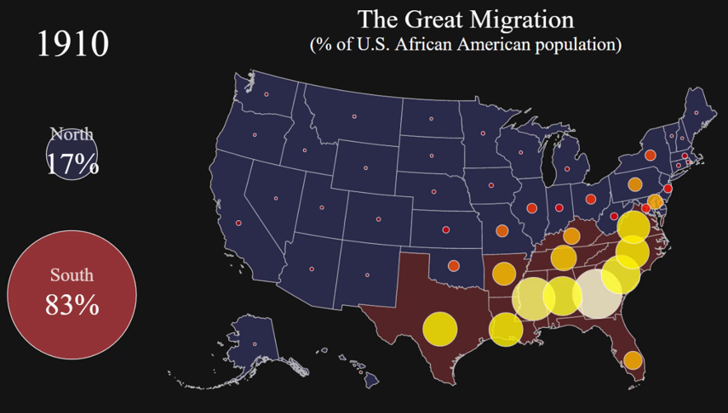
Why visualize data?
Make sense of complex data?
Entertainment / marketing?
Communicate numbers?
Tell a story?
Present a persuasive argument?
Visualizing the Great Migration, Metrocosm

Slide 7
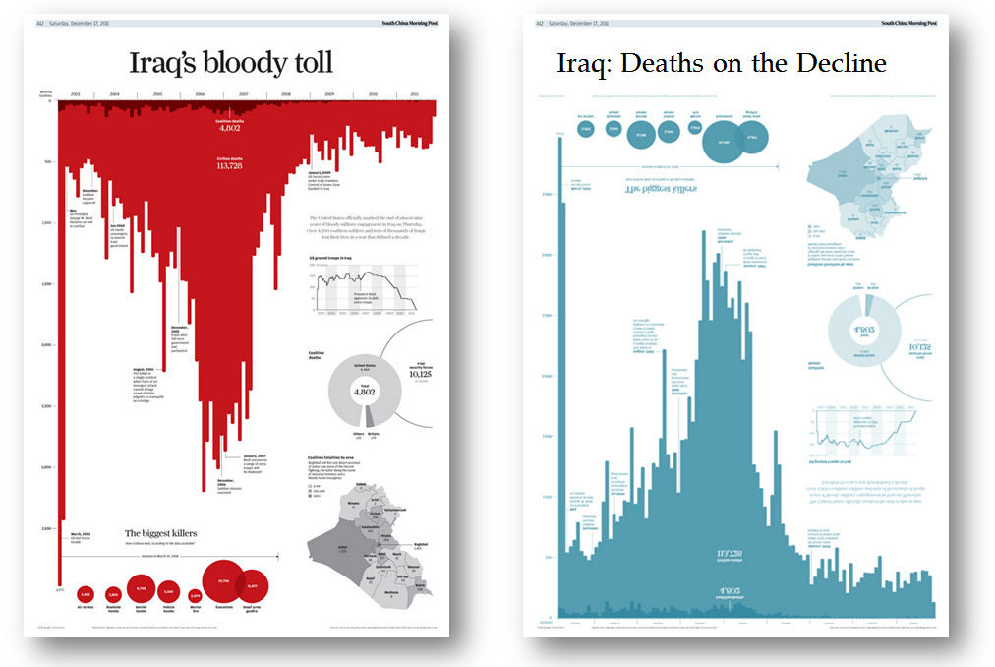
Data visualization: the aesthetics are the message
Iraq’s Bloody Toll, South China Morning Post

Slide 8
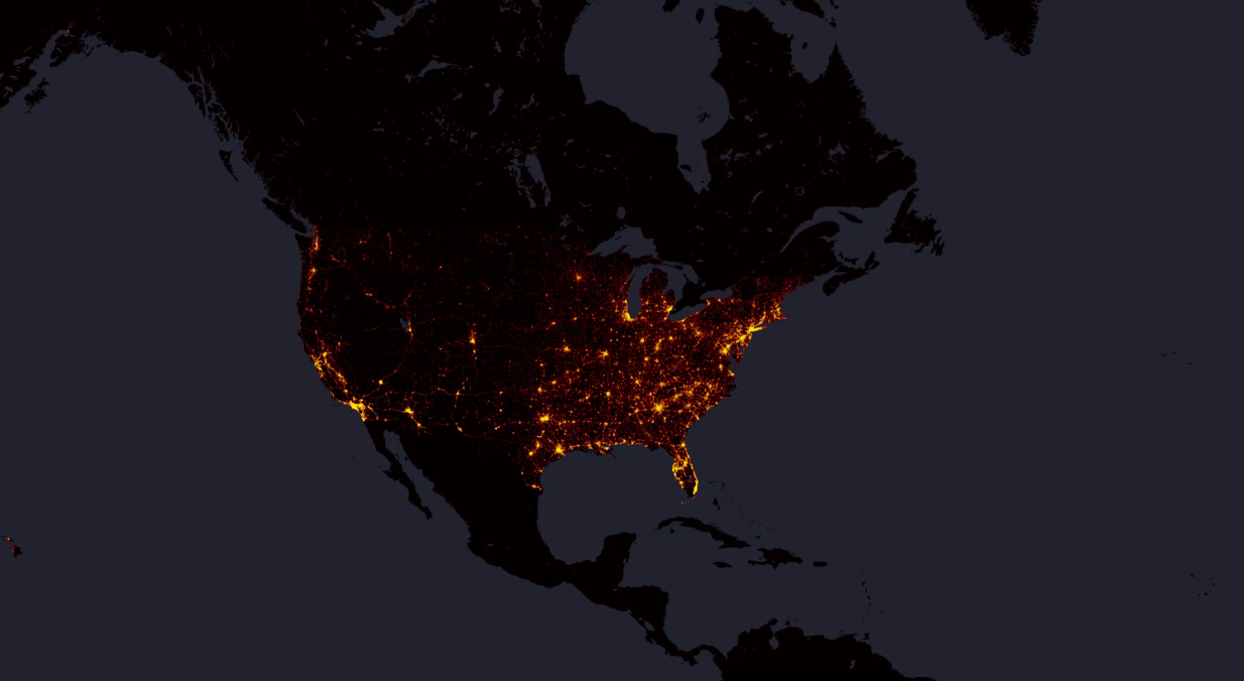
Data visualization: make statistics more human
10 Years of Fatal Traffic Crashes, Metrocosm

Slide 9
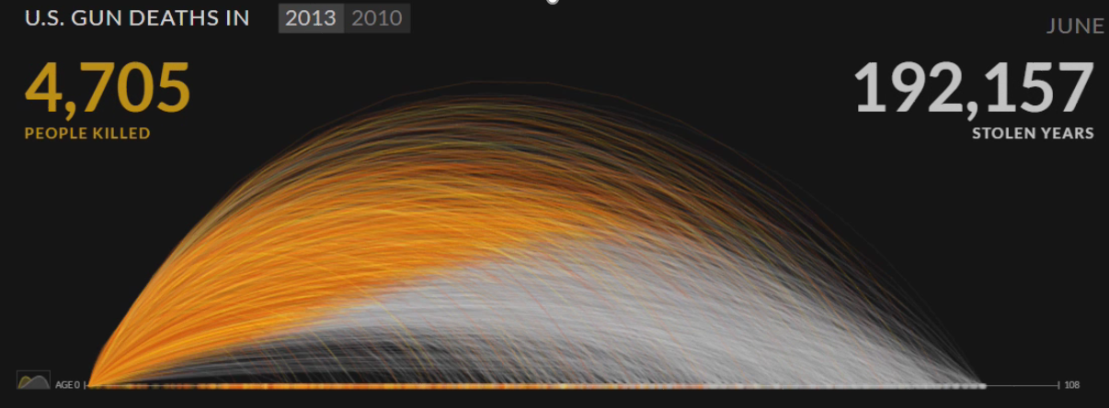
Data visualization: make statistics more human
One Year of U.S. Gun Deaths, Periscopic

Slide 10
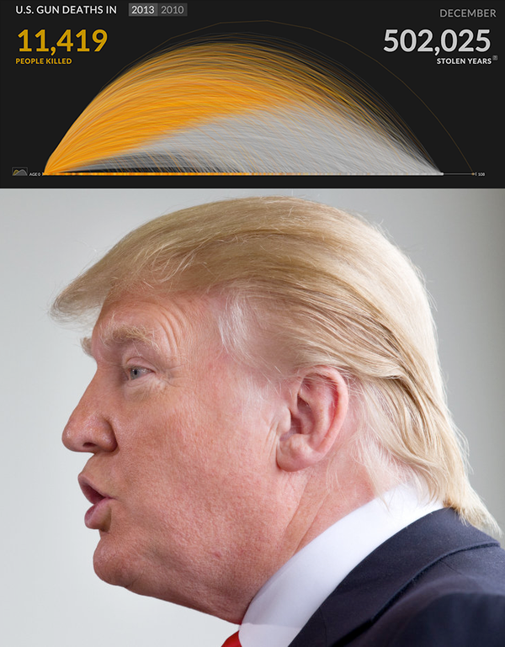
Data visualization: pattern recognition
#trumpviz, Mushon Zer-Aviv (@mushon)

Slide 11
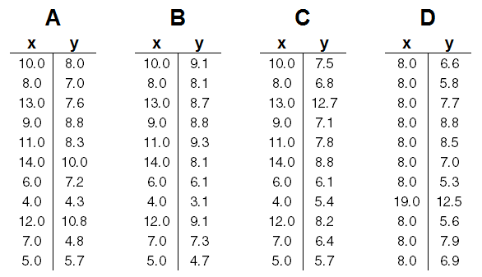
Data visualization: a medium for communicating numbers
The average x value is 9 for each dataset
The average y value is 7.50 for each dataset
The variance for x is 11 and the variance for y is 4.12
The correlation between x and y is 0.816 for each dataset
A linear regression for each dataset follows the equation y = 0.5x + 3
Anscombe’s Quartet, Francis Anscombe

Slide 12
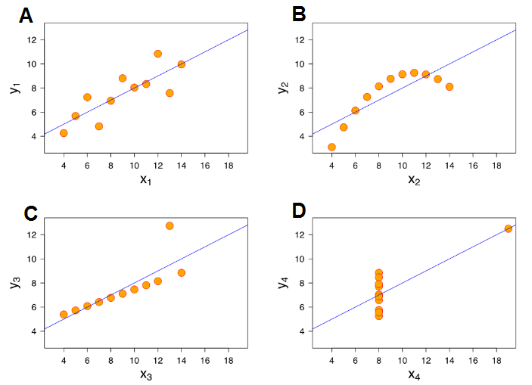
Data visualization: a medium for communicating numbers
The average x value is 9 for each dataset
The average y value is 7.50 for each dataset
The variance for x is 11 and the variance for y is 4.12
The correlation between x and y is 0.816 for each dataset
A linear regression for each dataset follows the equation y = 0.5x + 3
Anscombe’s Quartet, Francis Anscombe

Slide 13
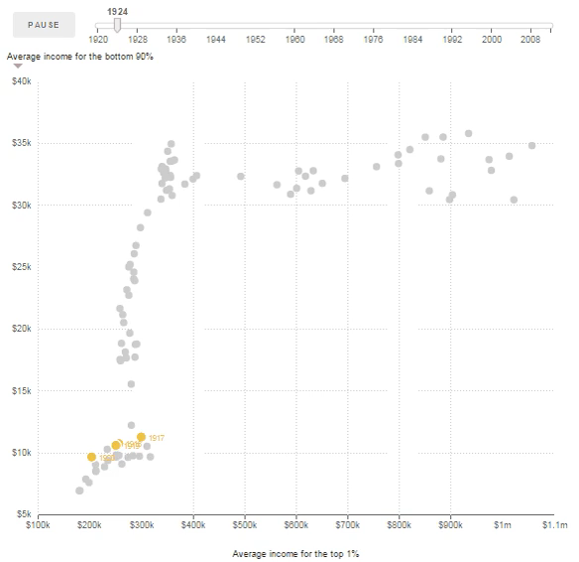
Data visualization: a medium for communicating numbers
The Fall and Rise of Inequality, NPR: Planet Money

Slide 14
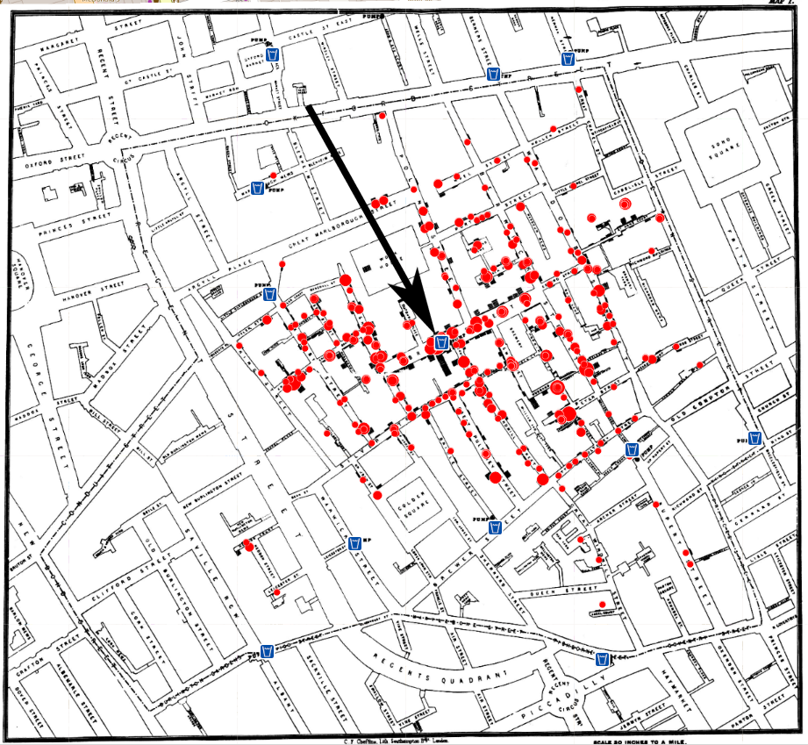
Data visualization: pattern recognition
John Snow’s London Cholera Map, 1854

Slide 15
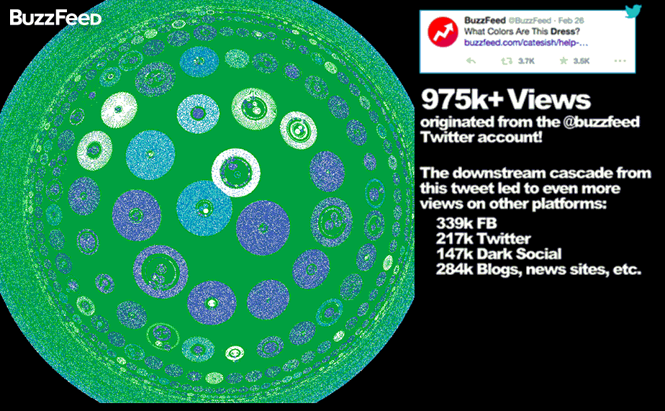
Data visualization: make sense of complex data (actionable insight)
Introducing Pound: Process for Optimizing and Understanding Network Diffusion, Buzzfeed

Slide 16
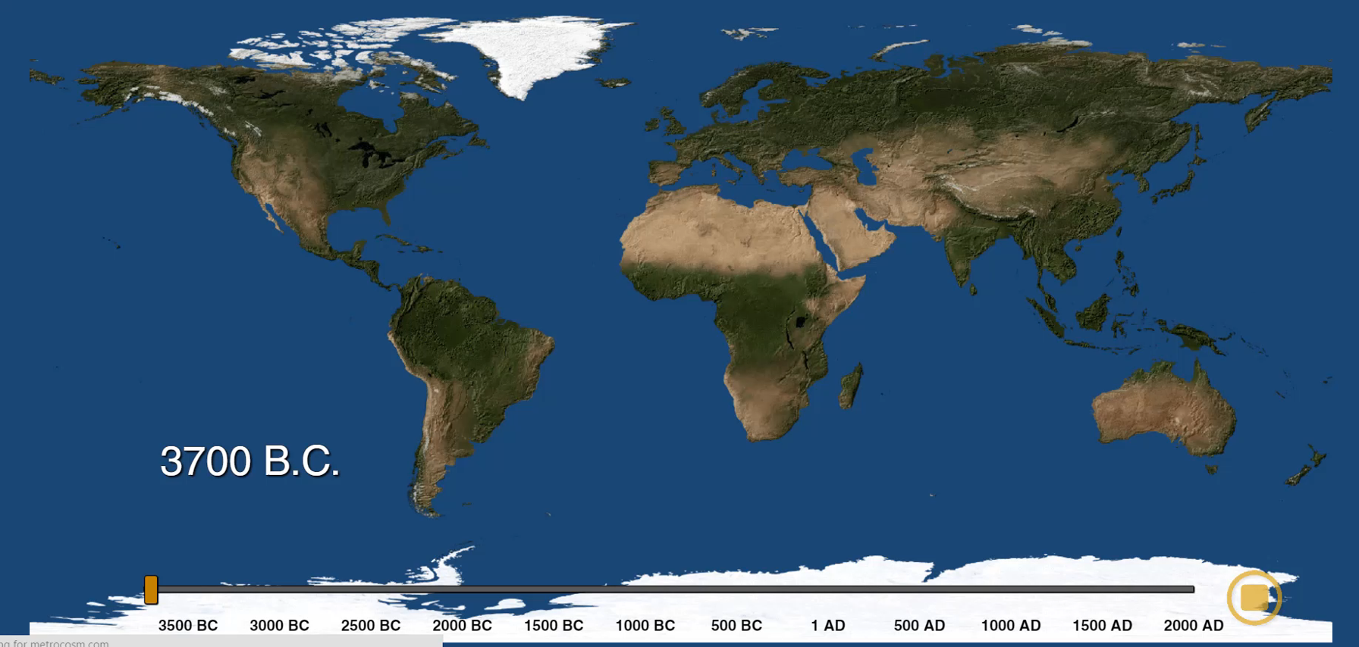
Data visualization: tell a story
The History of World Cities, Metrocosm

Slide 17
Lying With Data

Slide 18
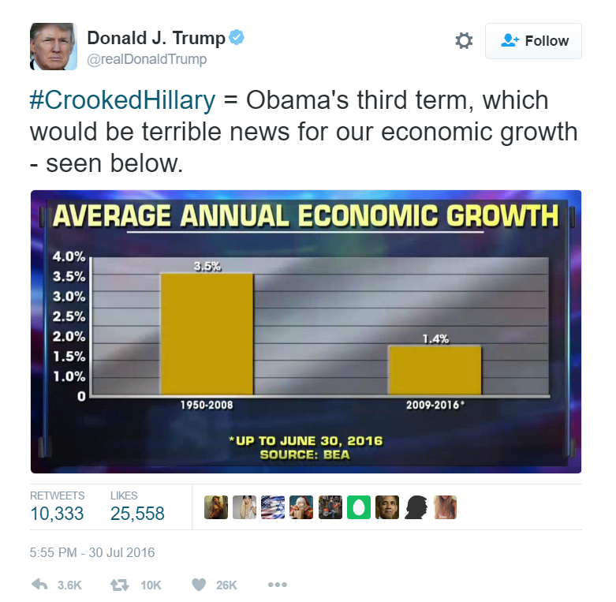
Good or Bad?
Trumpian data visualization, Alberto Cairo

Slide 19

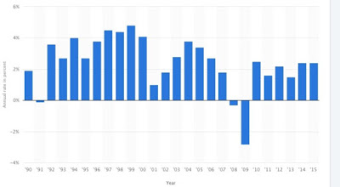
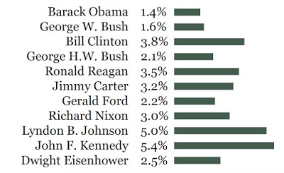
Selective Grouping
Trumpian data visualization, Alberto Cairo

Slide 20
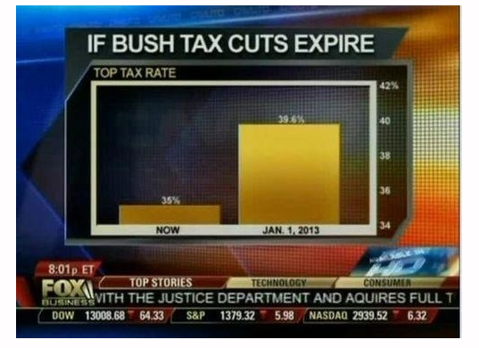
Good or Bad?

Slide 21
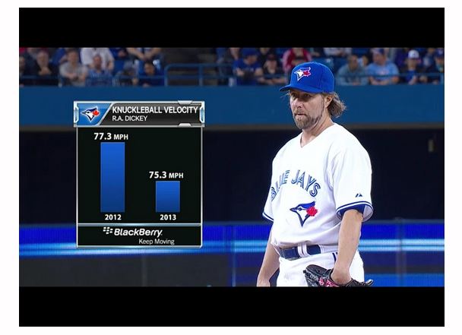
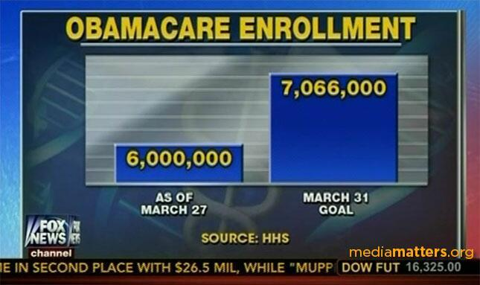
Truncated Axes: Never With Bar Charts

Slide 22
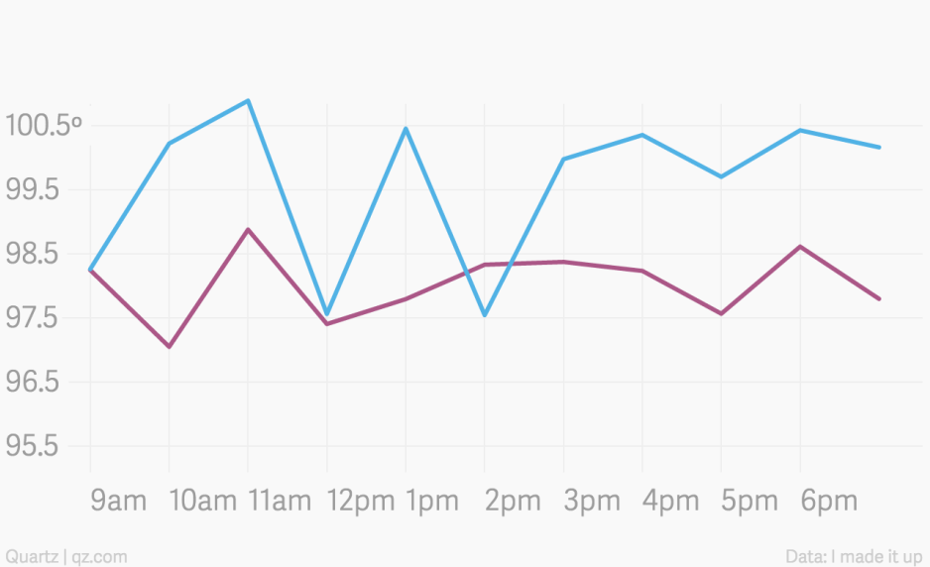
Good or Bad?

Slide 23

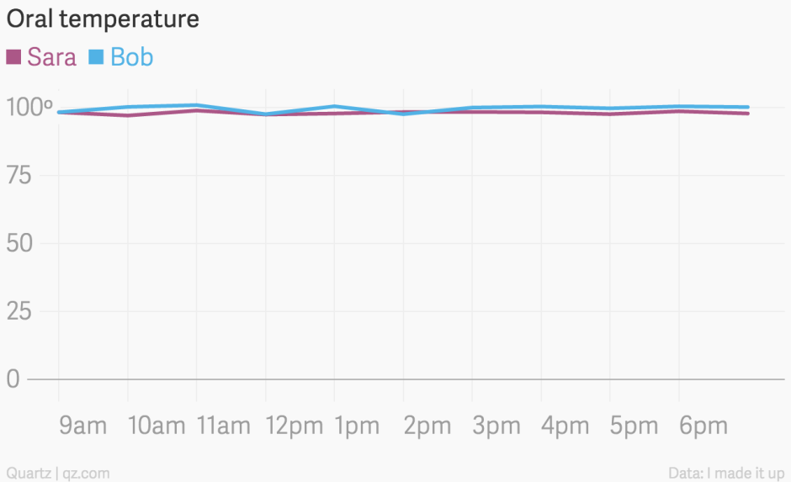
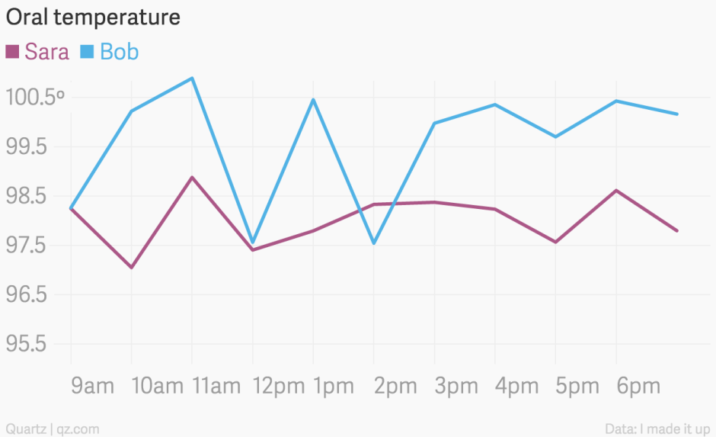
Truncated Axes: Sometimes It’s Wrong Not to
Who Has a Fever, Sarah or Bob?
It’s OK not to start your y-axis at zero, QZ

Slide 24
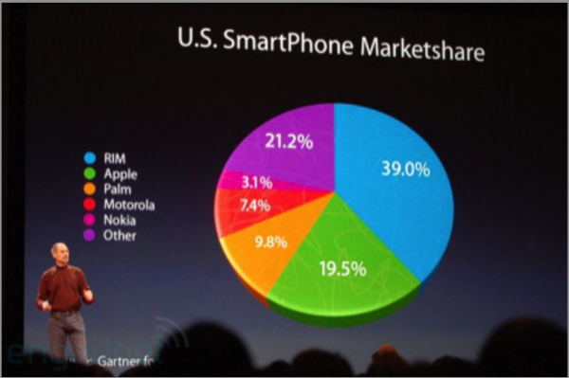
Good or Bad?

Slide 25
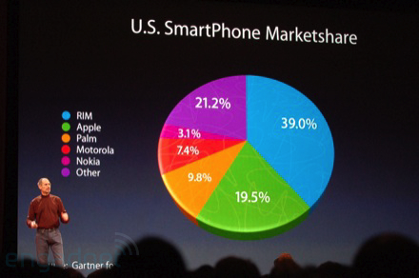
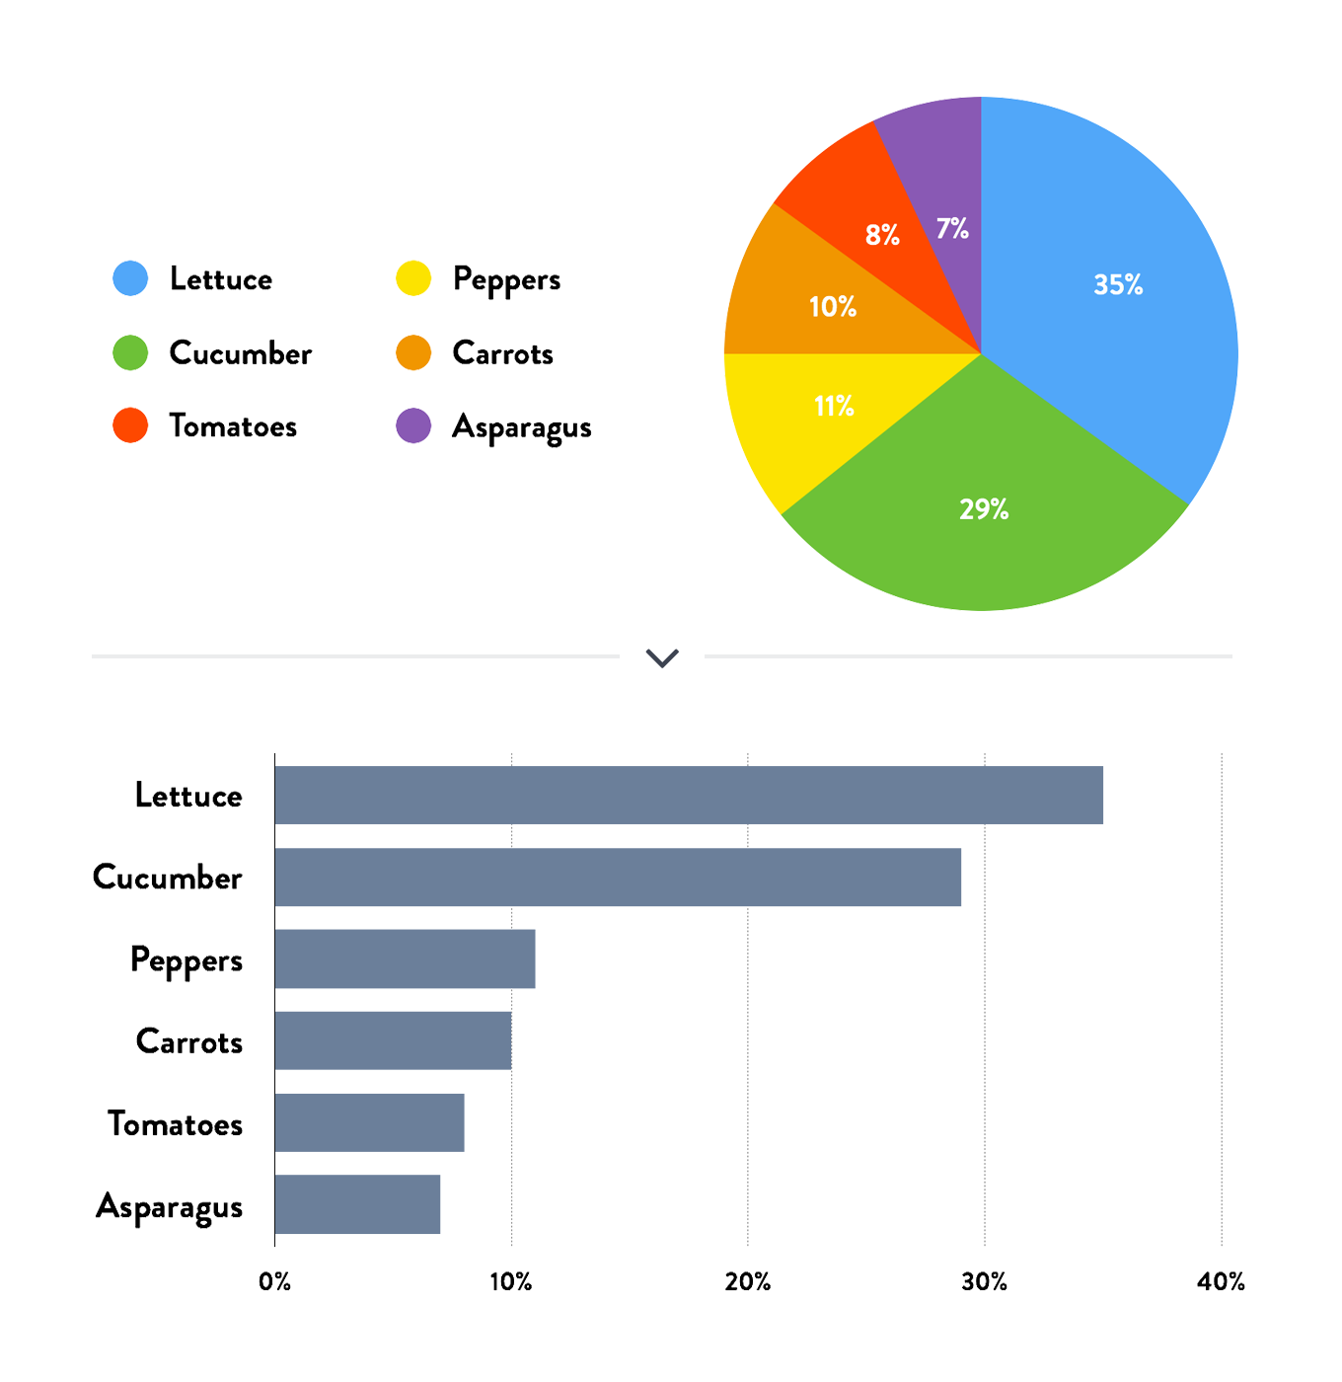
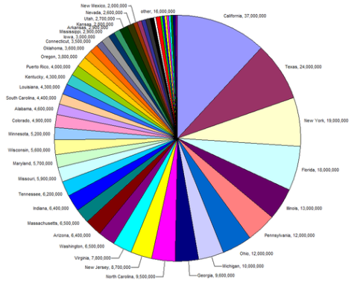
Pie Charts Are Rarely the Best Option
Neither are gratuitous 3D effects

Slide 26
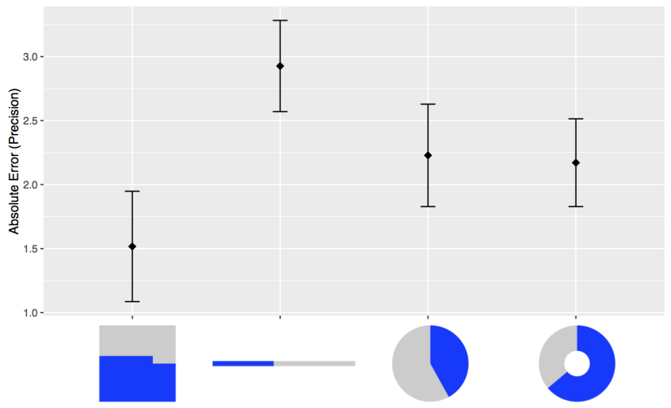
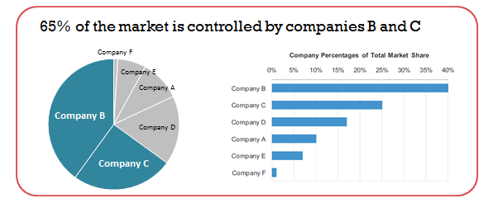
In Defense of Pie Charts
Eagereyes

Slide 27
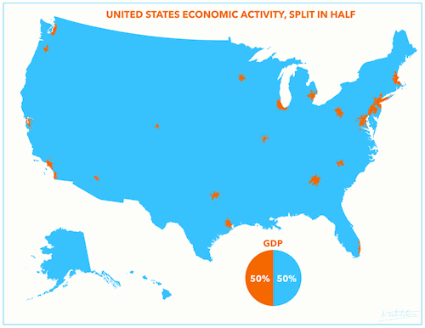
Good or Bad?

Slide 28
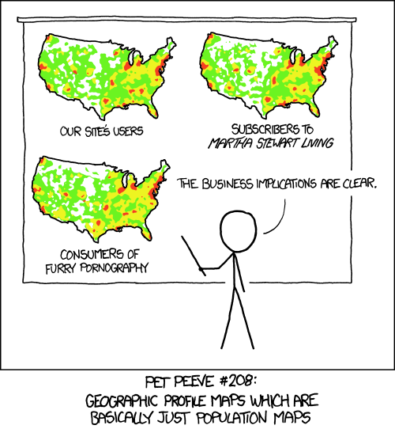
It’s Not “Just a Population Map”
XKCD 1138 / Thou Shalt Not Take XKCD 1138 in Vain, Andy Woodruff

Slide 29
Tips for Keeping it
Clear and Intuitive

Slide 30

Sophisticated visualizations are great in some cases, but…
Minard’s graphic of Napoleon in Russia

Slide 31
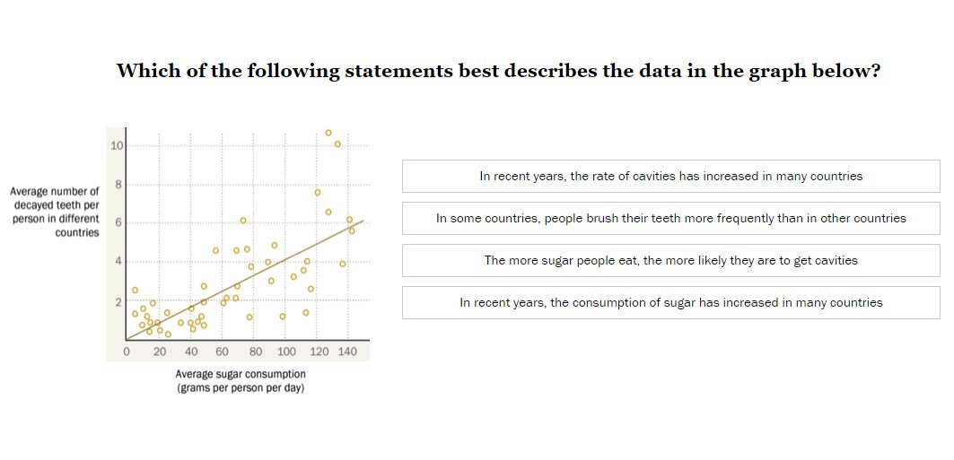
…for non-technical audiences, simple and intuitive is key
6 out of 10 U.S. adults can properly interpret this chart

Slide 32
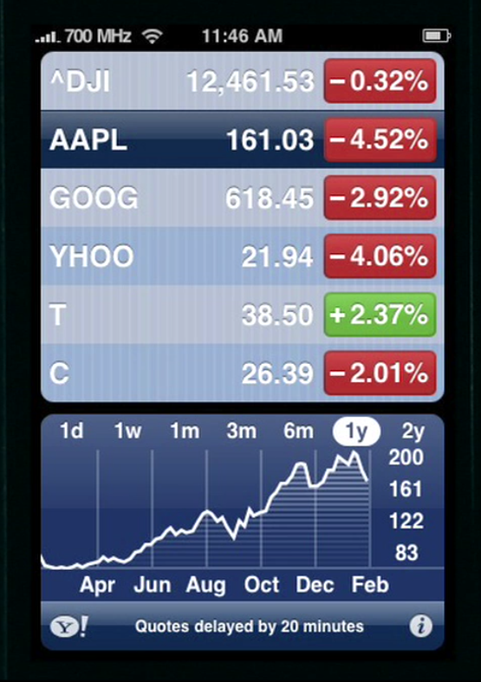
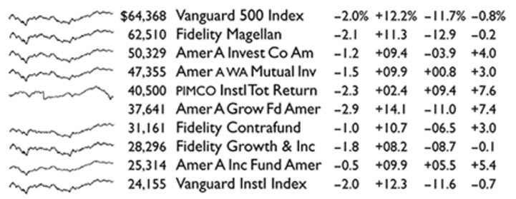
Practical Visualization Methods: Sparklines
It’s OK not to start your y-axis at zero, QZ
Notes:
Eye tracking, % of adults who can read a scatter plot

Slide 33
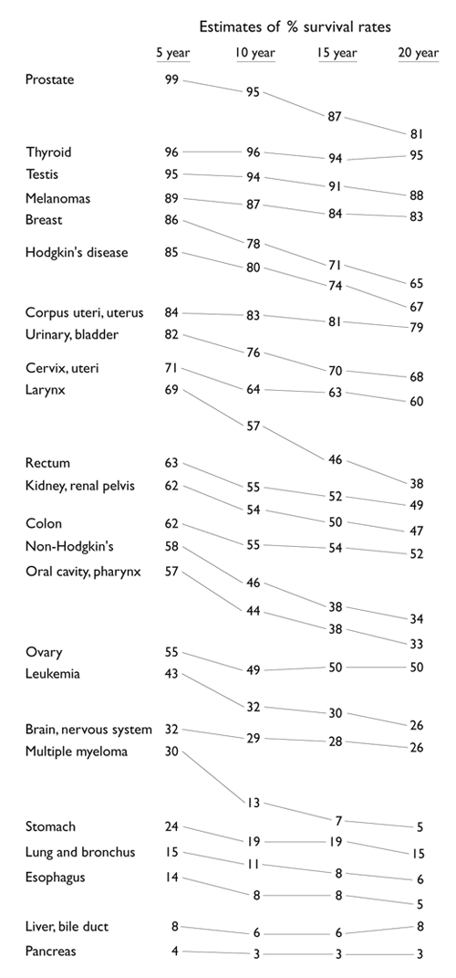
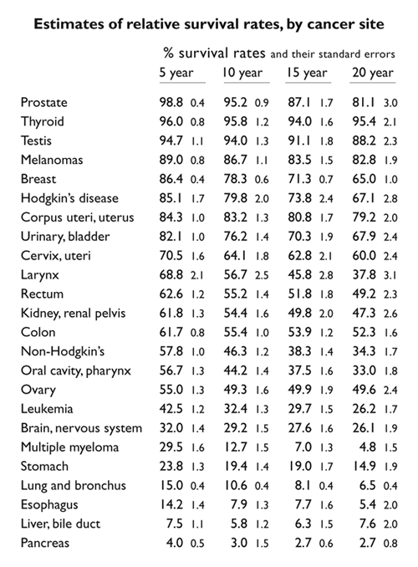
Practical Visualization Methods: Slopegraphs
Edward Tufte

Slide 34
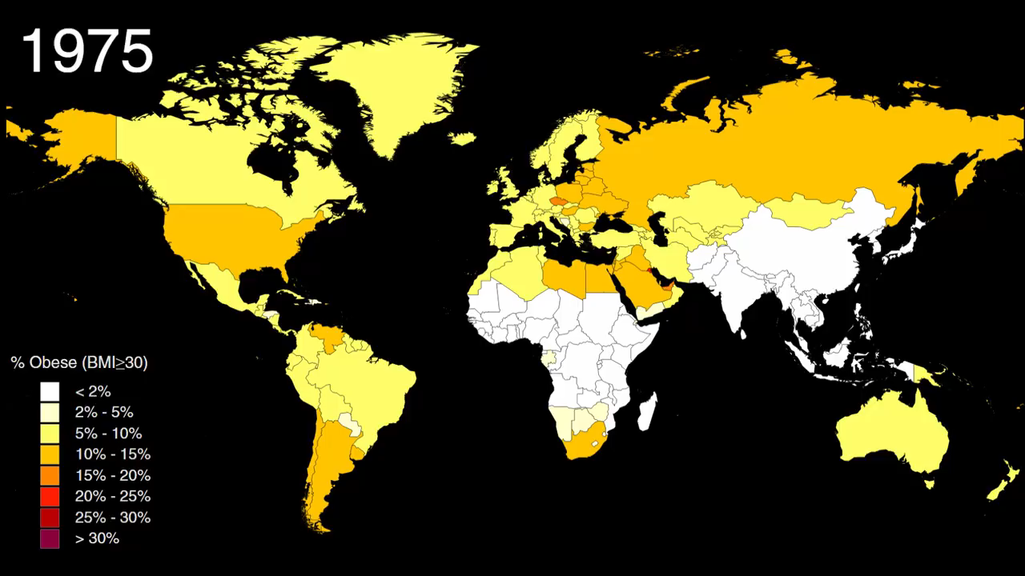
Practical Visualization Methods: Color With a Temporal Component
Data from 1,698 obesity studies covering 19.2 million participants
How the world got fat: a visualisation of global obesity over 40 years, The Guardian
Notes:
Eye tracking, % of adults who can read a scatter plot

Slide 35
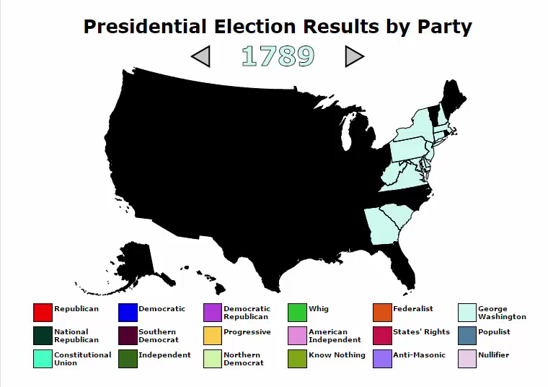
How Else Could This Map Be Visualized?
Metrocosm
Notes:
Eye tracking, % of adults who can read a scatter plot

Slide 36
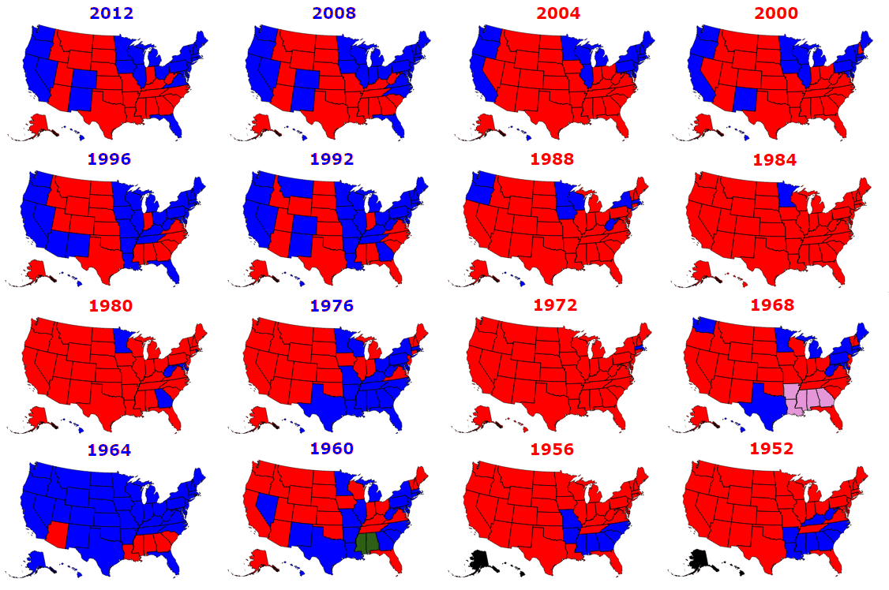
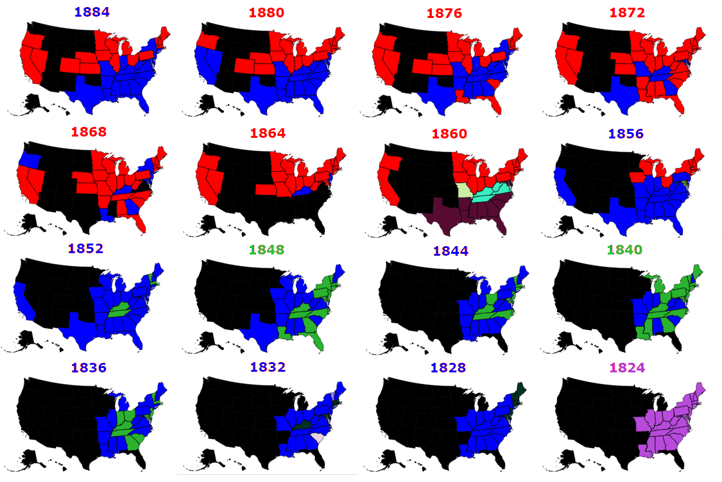
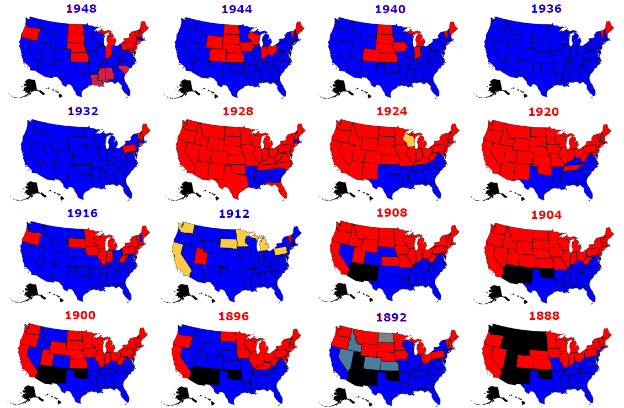
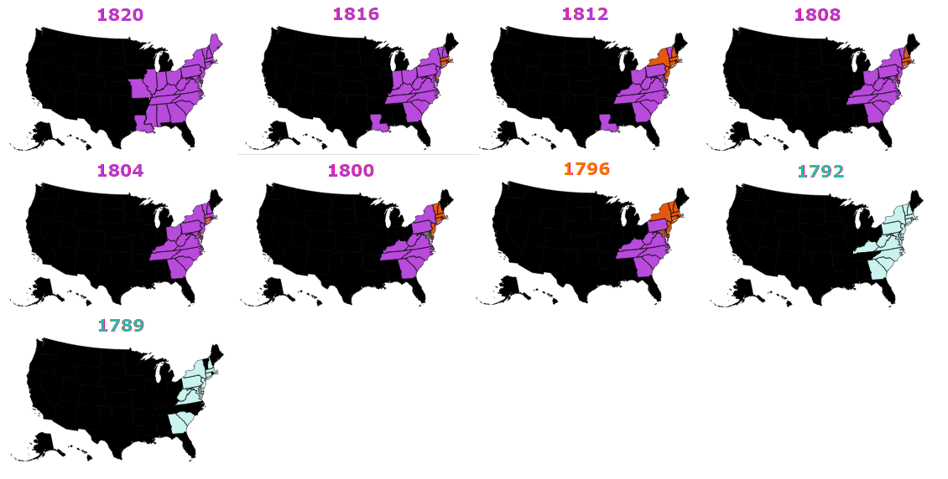
Practical Visualization Methods: Small Multiples
Metrocosm
Notes:
Eye tracking, % of adults who can read a scatter plot

Slide 37
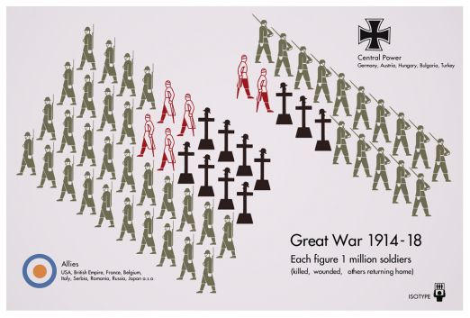
Practical Visualization Methods: Pictograms
For a great example of pictograms, see fallen.io

Slide 38
Color

Slide 39
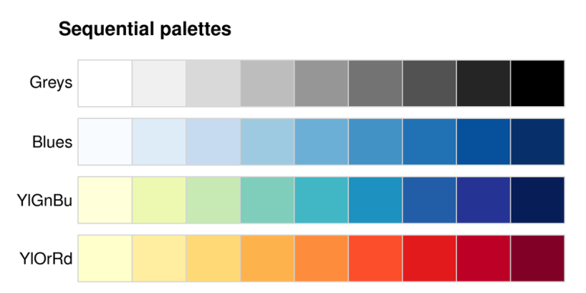
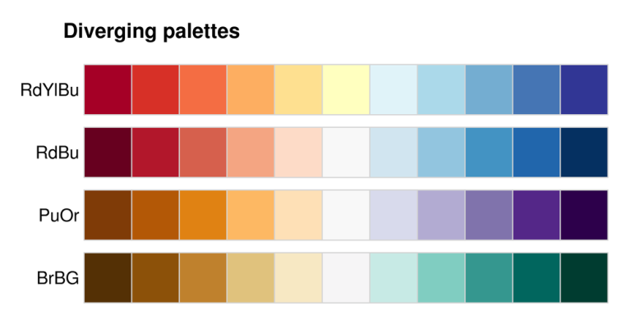
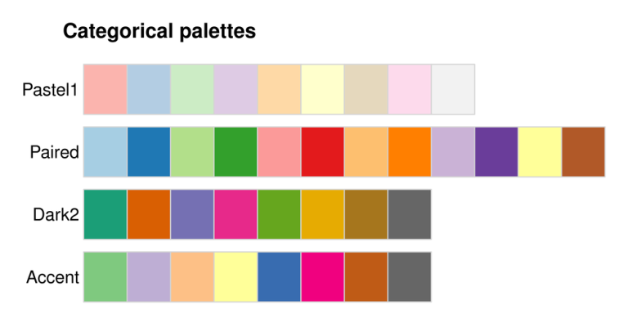
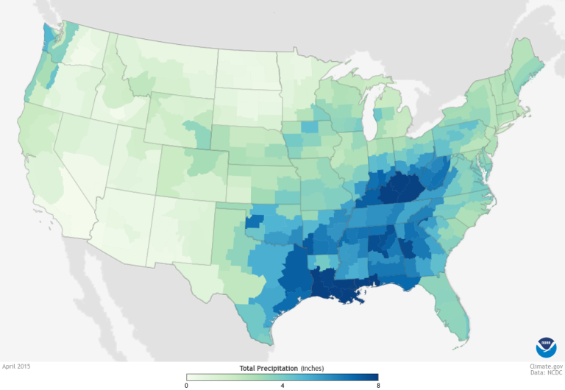
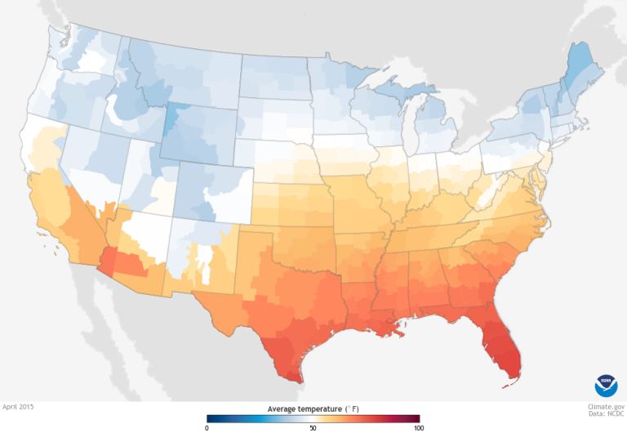
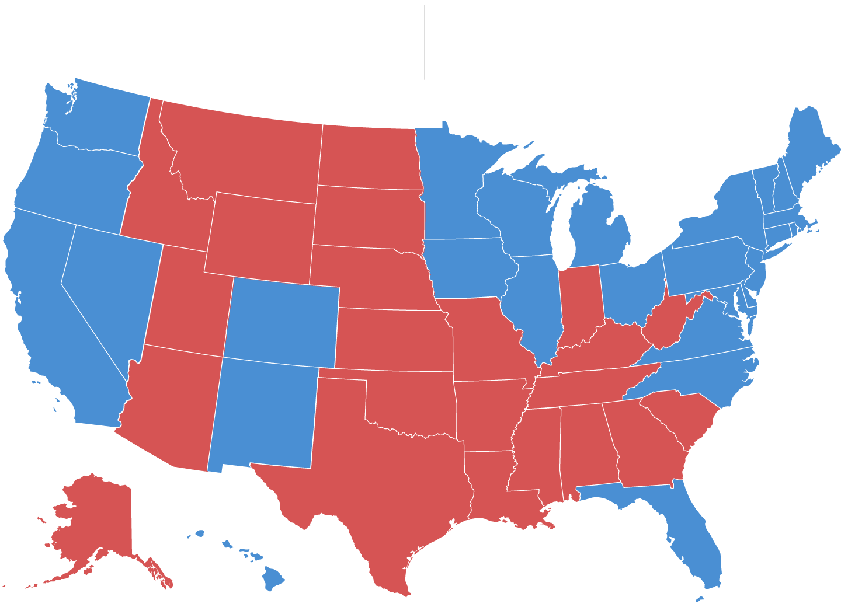
Color Scheme Type Should Always Match the Data Type
Used when the numbers go in one direction only:
Population density
Precipitation
Used when the numbers go in both directions:
More conservative – more liberal
Hotter -- colder
Used when the numbers go in both directions:
State flower
Winning election candidate
Colorbrewer
Notes:
Eye tracking, % of adults who can read a scatter plot

Slide 40




Perceptually Uniform Scales: Be Careful With Traditional RGB Model
Pure (100% saturated) colors vary greatly in perceived brightness
These scales are physically uniform, but not perceptually uniform
Notes:
Eye tracking, % of adults who can read a scatter plot

Slide 41


Perceptually Uniform Scales: HCL Model
HCL Model Perceptually Uniform
Traditional RGB Model Not Perceptually Uniform
In practical terms, use: colorbrewer.org, R viridis package, Chroma.js
Vis4
Notes:
Eye tracking, % of adults who can read a scatter plot

Slide 42


Colors That Match
color.adobe.com
Notes:
Eye tracking, % of adults who can read a scatter plot

